Slide 1
Infosys Springboard Air Fly Insights: Data Visualization and Analysis of Airline Operations Domain: Data Visualization Mentor: Rahul Yadav Submitted by: Avula Shivani Yadav

Slide 2

Imported airline delay dataset from Excel into Python using Pandas and verified data structure.
Analyzed dataset columns including airline, route, time, delay duration, and cancellation reasons.
Handled missing values by removing critical null entries and filling minor gaps using mean/median.
Preprocessed data by converting date-time fields and creating new features like month, day, and hour.
Prepared airline (aircraft) data by grouping, cleaning, and making it ready for analysis and visualization.

Slide 3
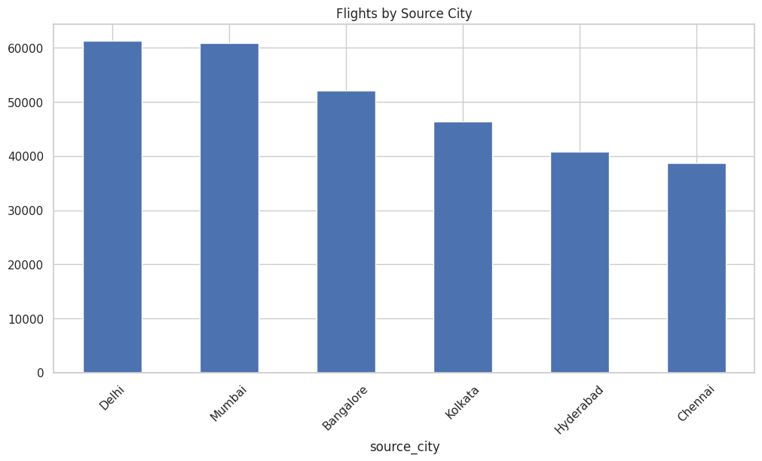
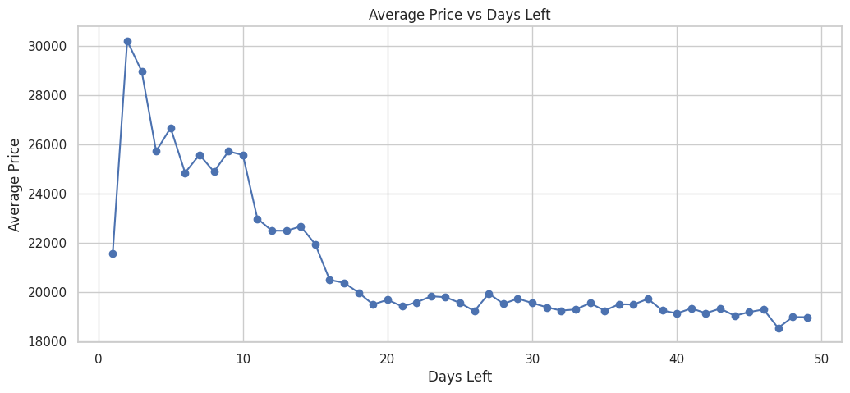
Univariate Analysis and Bivariate Analysis
Delhi and Mumbai have the highest flight departures, acting as major hubs.
Flight distribution varies significantly by source city.
Chennai and Hyderabad show lower flight traffic compared to metro hubs.
Average ticket prices mostly lie between ₹18,000–₹20,000, showing a stable price range for most booking days.
Trend: Price volatility is high in early days (1–10 days left) and becomes more stable for bookings made well in advance.

Slide 4
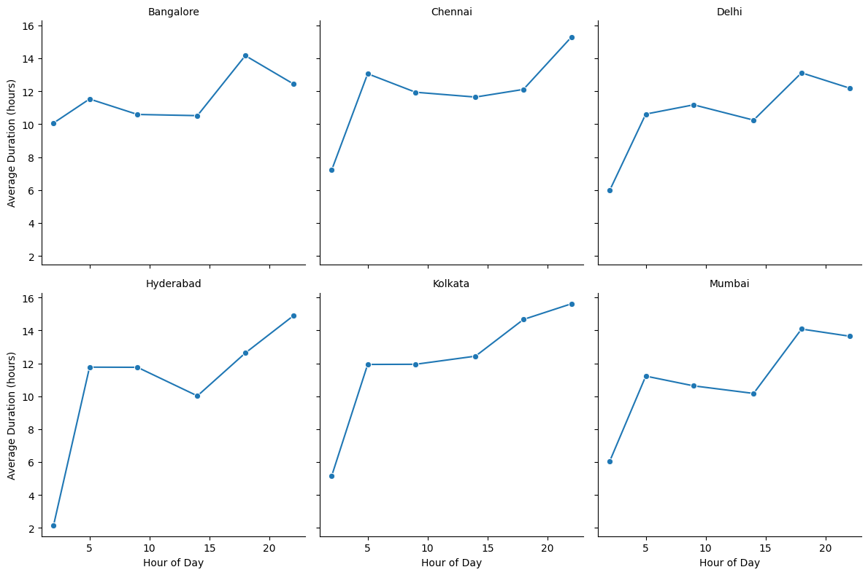
Delay Analysis – Airline and Weather
Average flight duration is lowest in early morning hours and increases as the day progresses.
Evening and night flights (around 18–22 hrs) show the highest durations across most cities.
While all cities follow a similar pattern, the magnitude of duration varies by city, with some showing sharper increases than others.

Slide 5
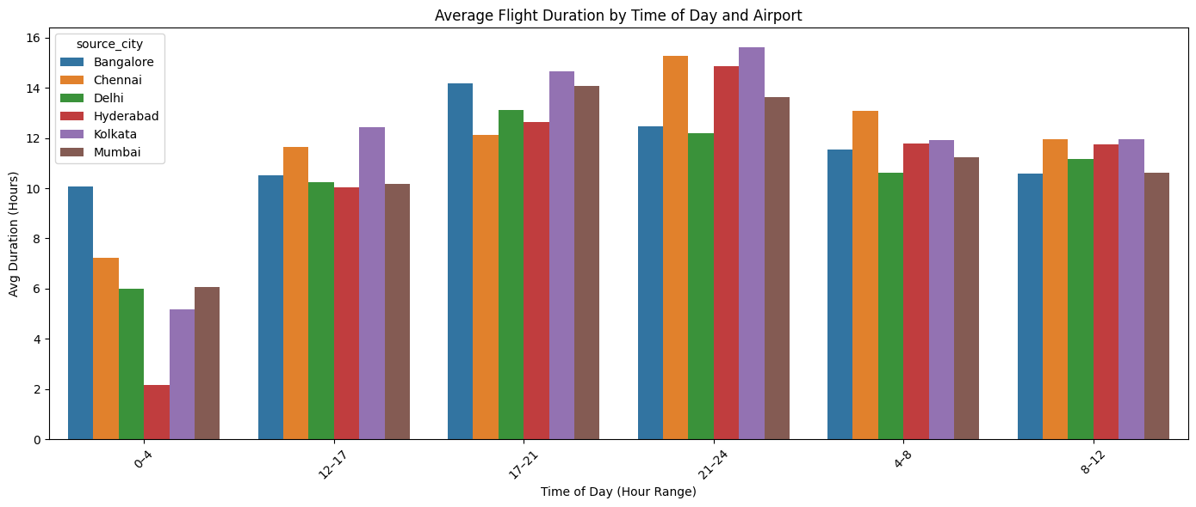
Delay Analysis – Airline and Weather
Average flight duration is highest during late evening/night (21–24) across all source cities.
Early morning (0–4) flights have the shortest durations, especially from Kolkata and Delhi.
All cities show a similar daily pattern, with durations rising from morning to night and then dropping again.

Slide 6
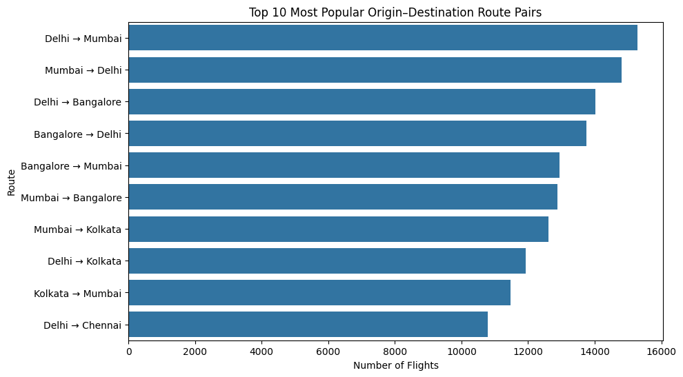
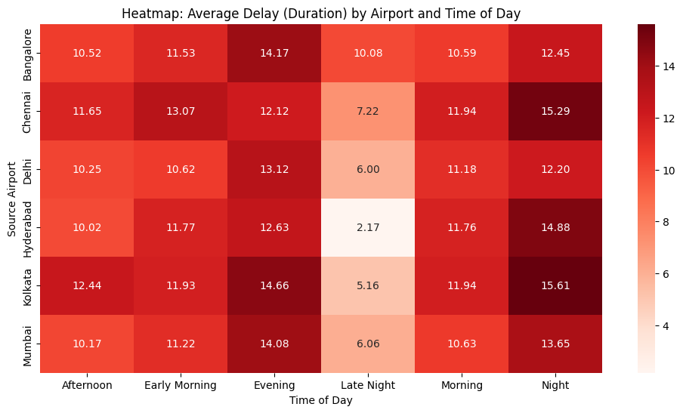
Route and Airport-Level Analysis
Evening and night time slots show the highest average delays across almost all airports.
Late night flights experience the lowest delays, especially from Hyderabad and Delhi.
Delay patterns are consistent across airports, with higher congestion-related delays during peak hours.

Slide 7
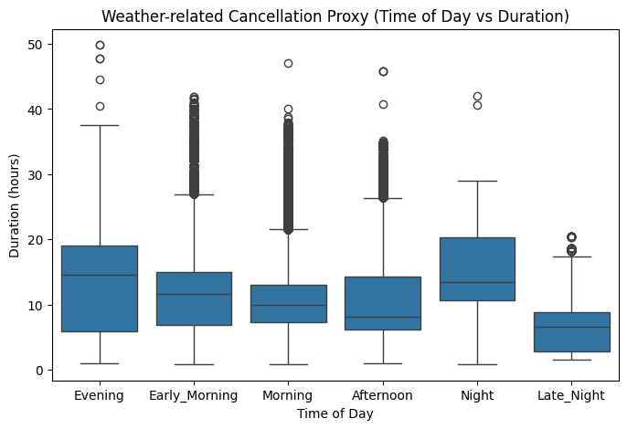
Seasonal and Cancellation Analysis
Evening and night periods show higher median durations and wider spread, indicating stronger weather-related impact.
Late night flights have the lowest durations with less variability, suggesting minimal weather disruptions.
Early morning and morning show moderate durations but include several high outliers, reflecting occasional severe weather effects.

Slide 8
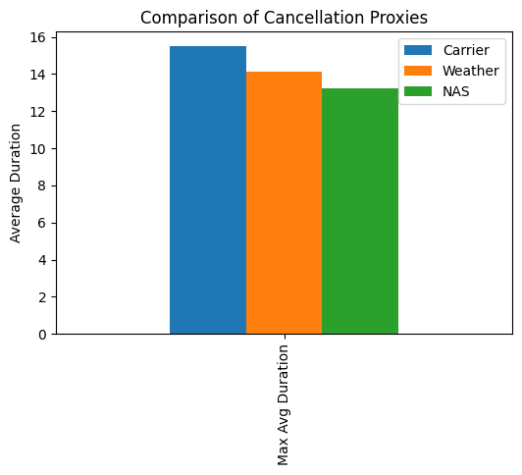
Carrier-related cancellations have the highest average duration, indicating the strongest overall impact.
Weather-related cancellations show slightly lower but still significant average durations.
NAS-related issues have the lowest average duration among the three categories.

Slide 9
Final findings from the project
Pricing & booking behavior: Flight prices are highest close to departure and decrease as booking is done earlier, with prices stabilizing well in advance.
Time-of-day impact: Flight duration and delays increase during evening and night hours, while early morning and late-night flights are generally shorter and less delayed.
Route demand: Metro routes, especially Delhi–Mumbai, Delhi–Bangalore, and Mumbai–Bangalore, dominate air traffic, indicating strong business and commuter demand.
Delay patterns: Evening and night experience the highest average delays across airports; late night shows the least congestion and delays.
Cancellation factors: Carrier-related issues have the highest impact, followed by weather, while NAS-related causes show relatively lower impact.

Slide 10
THANK YOU

